Slide 1
Content Objective: Students will determine which future scenario is most likely for humanity by constructing an argument.
Friday January 24th
Recap Last Class - Robot Trained on Virtue Ethics
3 Future Scenarios
Construct an Argument
Homework
During projects only...

Slide 2
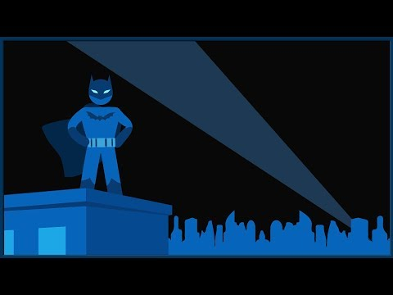
What is meant by “Gray” Ethics?
What is the actual name for “gray” ethics...

Slide 3
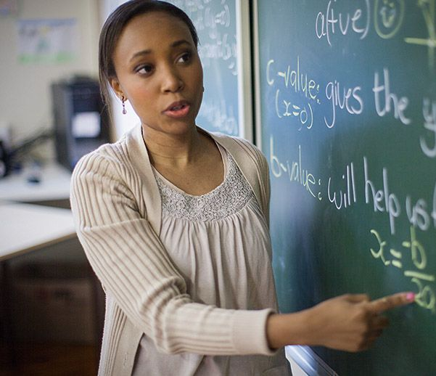
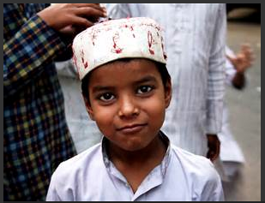
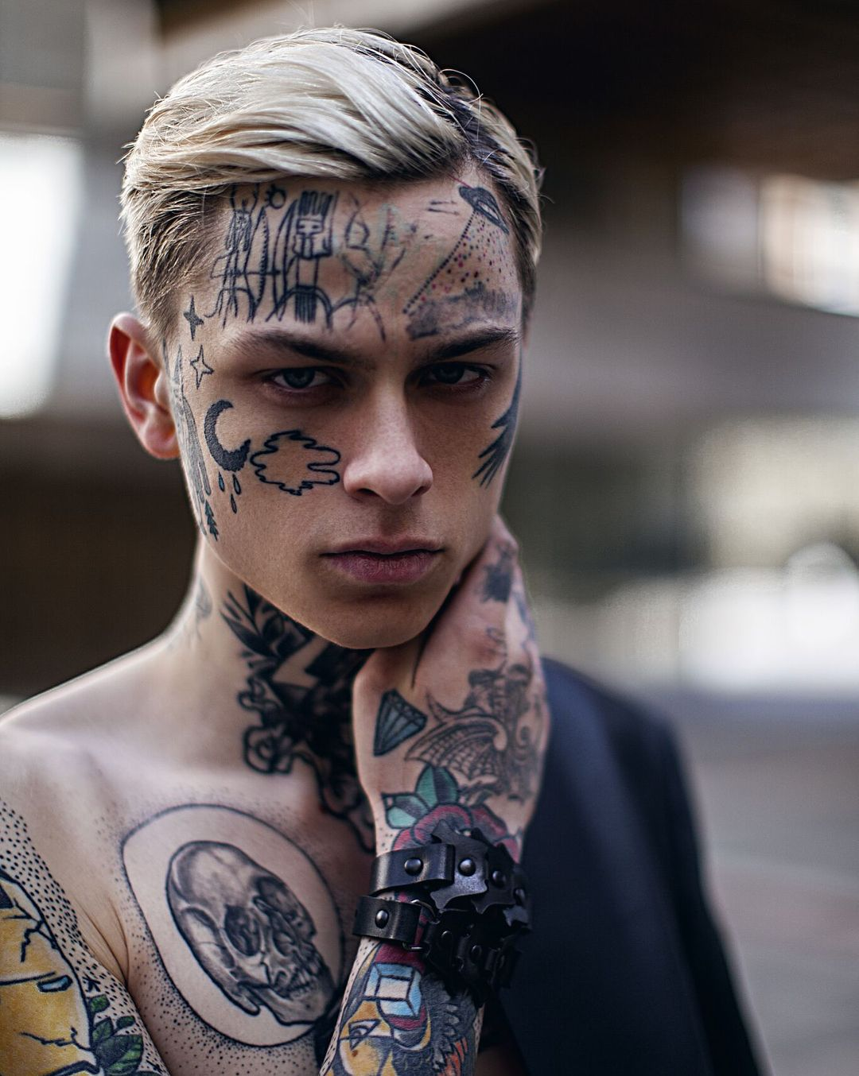
Which Human would you trust?
A. B. C.
Will punish those who do wrong and reward those who do right. Believes there is a right and a wrong.
Will always ask “why?” when making a choice. Believes in the gray. Does not believe in good or evil.
Will always choose the option that leads to the greatest good for the greatest number.

Slide 4
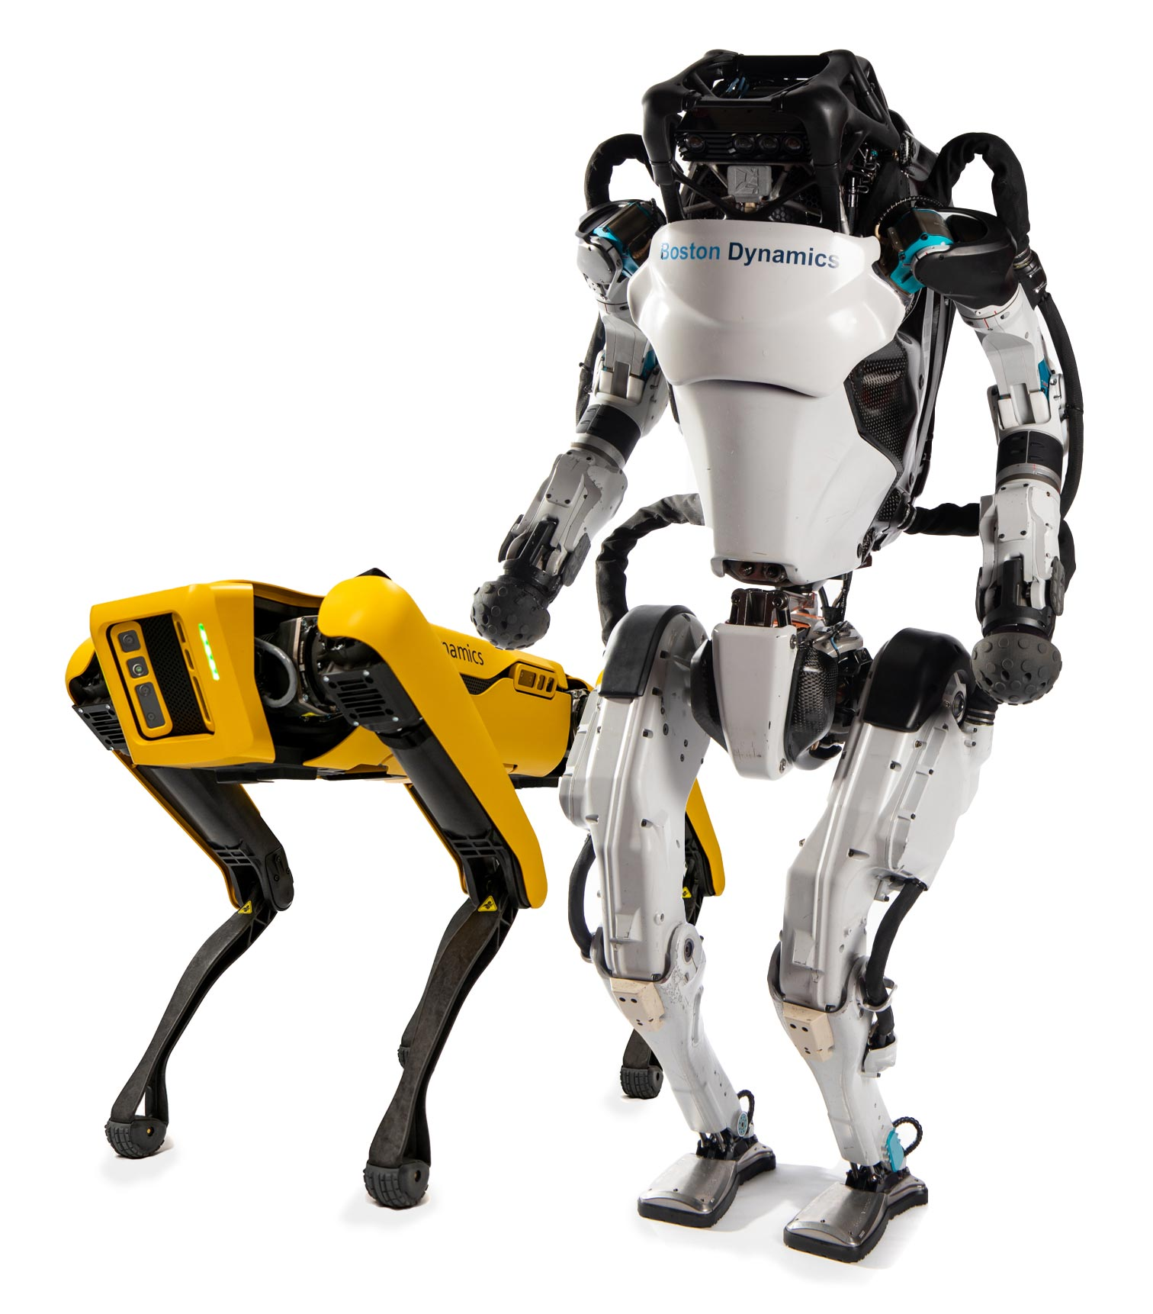
Which Robot would you trust?
A. B. C.
Will always choose the option that leads to the greatest good for the greatest number. Ex. Hires you because you are willing to be a slave for the company.
Will punish those who do wrong and reward those who do right. Believes there is a right and wrong. Ex. Hires you because you are NOT religious.
Will always ask “why?” when making a choice. Believes in the gray, not in good or evil. Ex. Hires you because your character is most likely going to help the company.

Slide 5
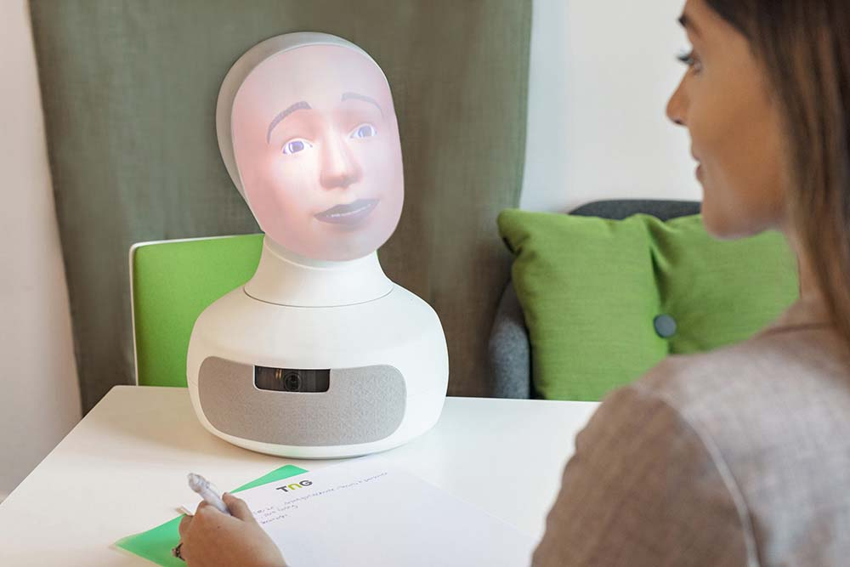
What does Robot C. really look like?
Meet Tengai - The Virtue Ethicist Robot

Slide 6
Day 1 - Social Impact
Why is it important to consider ethics and AI?
What is society? What do we view as being a good or bad society?
Who are the ones making the machines? Programming the machines? As we will learn later on, AI learns from us...are we always a good example?
See Hanson Robotics Website ----> Sophia
What might the ethical code of these people be as they create this robot?
Do you think they have similar or different ethics to us here in the classroom?

Slide 7
Scenario 1 - The Day the Yogurt Took Over
Scenario 2 - The Second Renaissance (9 min in)
Scenario 3 - Sophia Talks About Her Plan
Let’s look at three different societal scenarios...categorize these as being either “evil,” “neutral,” or “good.” Come up with reasons why you feel these outcomes are good or bad and be ready to defend your thinking. Jot down significant moments that seem to go against (or with) your own ethical code.

Slide 8
Which Scenario do you believe is the most likely?
Get in a group of 2-3 and construct an argument for which one of these scenarios you believe is the most likely to play out in the future. Compare / contrast your ethical codes to help guide you. Write 2-3 paragraphs to defend your reasoning.

